Slide 1
Chapter 15: View Serializability

Slide 2
View Serializability
Conflict equivalent
Conflict serializable
View equivalent
View serializable

Slide 3
Motivating example
Schedule Q T1
T2
T3
Read(A)
Write(A)
Write(A)
Write(A)

Slide 4
Same as
Q = r1(A) w2(A) w1(A) w3(A)
P(Q): T1 T2
T3
Not conflict serializable!

Slide 5
But now compare Q to Ss, a serial schedule:
Q T1 T2
T3
Read(A)
Write(A)
Write(A)
Write(A)
Ss T1
T2
T3
Read(A) Write(A)
Write(A)
Write(A)

Slide 6
T1 reads same thing in Q, Ss
T2, T3 read samething (nothing?)
After Q or Ss, DB is left in same state
So what is wrong with Q?

Slide 7
Definition Schedules S1,S2 are
View Equivalent if:
(1) If in S1: wj(A) ⇒ ri(A) then in S2: wj(A) ⇒ ri(A)
⇒ means “reads value produced”
If in S1: ri(A) reads initial DB value, then in S2: ri(A) also reads initial DB
value
If in S1: Ti does last write on A,
then in S2: Ti also does last write on A

Slide 8
Definition
Schedule S1 is View Serializable if it is view equivalent to some serial schedule

Slide 9
View Serializable
Conflict Serializable
?
View Serializable ⇒ Conflict Serializable e.g., See Schedule Q
Conflict Serializable ? View Serializable
⇒

Slide 10
Lemma
Conflict Serializable ⇒ View Serializable
Proof:
Swapping non-conflicting actions does not change what transactions read nor final DB state

Slide 11
Venn Diagram
All schedules
View Serializable
Conflict Serializable

Slide 12
Note: All view serializable schedules that are not conflict serializable, involve useless write
S = W2(A) … W3(A)…..
no reads
FALSE: Counterexample (Sorav Bansal): w₃(Y) r₂(Y) w₁(X) r₂(X) w₃(X) r₄(X) w₅(X)

Slide 13
How do we test for view- serializability?
P(S) not good enough… (see schedule Q)

Slide 14
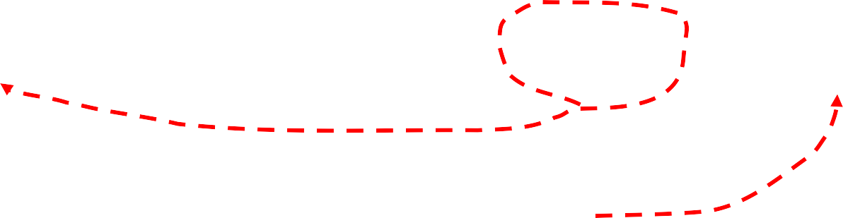
One problem: some swaps involving conflicting actions are OK… e.g.:
S = ….w2(A)……r1(A).... w3(A)…
this action can move if this write exists
w4(A)

Slide 15
Another problem: useless writes
S = …..W2(A)…….. W1(A)…..
no A reads

Slide 16
To check if S is View Serializable
(1) Add final transaction Tf that reads all DB
(eliminates condition 3 of V-S definition)
?
S = …..W1(A)…….. W2(A)…
Last A write
E.g.:
rf(A)
add

Slide 17
(2) Add initial transaction Tb that writes all DB
(eliminates condition 2 of V-S definition)
?
E.g.: S = wb(A) ... r1(A) … w2(A) …
add

Slide 18
(3) Create labeled precedence graph of S: (3a) If wi(A) ⇒ rj(A) in S, add Ti → Tj
0

Slide 19
(3b) For each wi(A) ⇒ rj(A) do consider each wk(A): [Tk ≠Tb]
then insert
some new p
- If Ti ≠Tb ∧ Tj ≠Tf
Tk →^{p} Ti
Tj →^{p} Tk
- If Ti =Tb ∧ Tj ≠Tf
Tj →⁰ Tk
then insert
- If Ti ≠Tb ∧ Tj =Tf
Tk →⁰ Ti
then insert

Slide 20
(4) Check if LP(S) is “acyclic” (if so, S is V-S)
- For each pair of “p” arcs (p ≠ 0), choose one

Slide 21

Example: check if Q is V-S: Q = r1(A) w2(A) w1(A) w3(A)
Q’ = wb(A)⇒ r1(A) w2(A) w1(A) w3(A)⇒ rf(A)
T1
0
rule 3(a) rule 3(b)
0
T2
0
0
rule 3(b)
Tb
Tf
0
0
LP(S) acyclic!!
S is V-S
T3

Slide 22
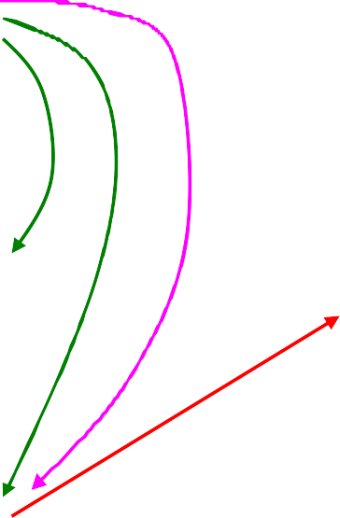
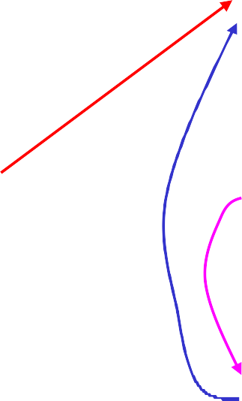
Another example:
Z=wb(A)⇒r1(A) w2(A)⇒r3(A) w1(A) w3(A)⇒rf(A)
T1
1
0
0
₀ T2
0
Tb
0
Tf
1
0
0
do not pick this one of “1” pair
T3
LP(Z) acyclic, so Z is V-S (equivalent to Tb T1 T2 T3 Tf)

Slide 23
Ss=wb(A)r1(A)w1(A)w2(A)r3(A)w3(A)rf(A)
T1 T2 T3
Z + Ss indeed do same thing

Slide 24
Checking view serializability is expensive
Still, V-S useful in some cases...

Slide 25
Example on useless transactions:
S = w1(A) r2(A) w2(B) r1(B) w3(A) w3(B)

Slide 26
Tb w1(A)⇒r2(A)w2(B)⇒r1(B) w3(A)w3(B) ⇒Tf
S’ =
T1
Tb
0
0
T3
0
Tf
T2

Slide 27
If we only care about final state remove T1, T2; i.e., remove useless transactions
If we care what T1, T2 read (view equivalence), then do not remove useless transactions

Slide 28
If all transactions read what they write, (I.e., Tj=... Rj(A) … Wj (A)…) then
view serializability = conf. serializability
[Another way of saying: blind writes appear in any view-serializable schedule that is not conflict serializable]

Slide 29
Proof(?): say S1 is view-ser. and no blind writes. S1 V-equiv to Ss, serial schedule.
Goal: Show that
T1 → T2 in P(S1) ⇒ T1 <ssT2
Assume T1 → T2
if S1 = …w1(A) … r2(A)…
(direct read) clearly T1 <ssT2 if S1 = …w1(A)… r3(A) w3(A) ... r2(A)…
also T1 <ssT2
if S1 =...r1(A) r3(A) … w1(A) … w3(A) … r2(A)
not possible: T1,T3 not
serializable
^{C}O^{S} t²⁴h⁵er cases similar...
Notes 11 29

Slide 30
Implications:
If no blind writes, view-ser ⇐⇒ conf-ser
P(S) acyclic ⇒ all transactions read the same as in a serial schedule
CS 245
Notes 11
30

